Slide 1
Mental Health & Wellness
Stress

Slide 2
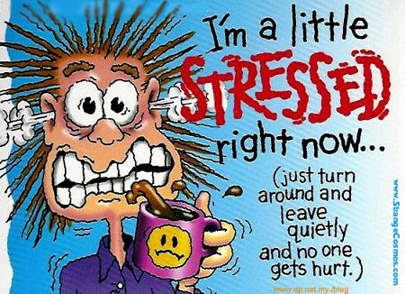
What is stress?
A feeling that’s created when we react to particular events
The body’s way of rising to a challenge and preparing to meet a tough situation with focus, strength, stamina and heightened alertness

Slide 3
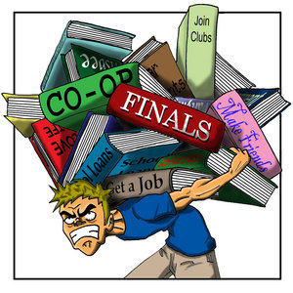
How is stress created?
Events that cause stress are called STRESSORS.
These events cover a whole range of situations:
Physical danger
Giving a speech
Writing a test
…other ideas?

Slide 4
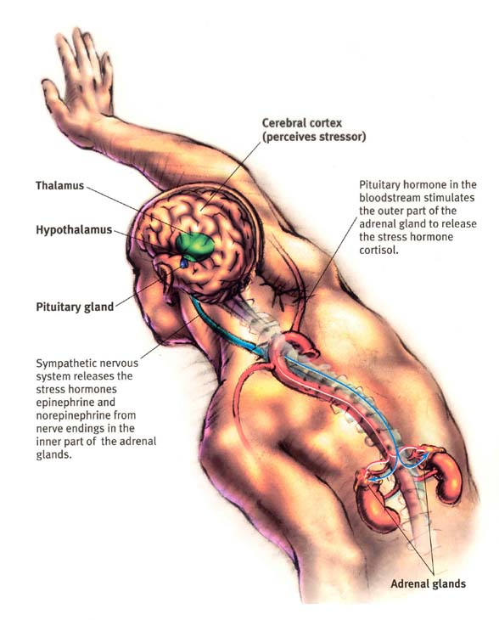
How does the human body respond to stress?
Once a stressor is detected, the nervous system is activated which triggers a specific kind of hormonal release
The hypothalamus signals the adrenal glands to produce more of the hormones adrenaline and cortisol into the bloodstream
- These hormones cause the heart & lungs to speed up their processes, as well as an increase in blood pressure and metabolism

Slide 5
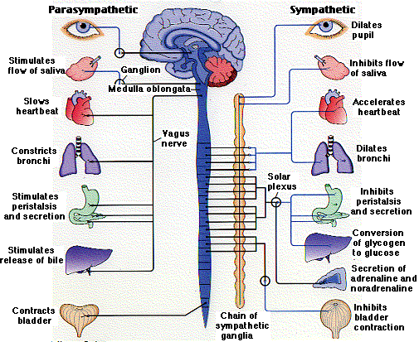
How does the human body respond to stress?
3. Blood vessels dilate (open wider) to increase blood flow to large muscle groups
4. Pupils dilate to improve vision
5. The liver releases glucose to increase energy levels
6. Sweat is produced to cool the body

Slide 6
Why does the body react that way to stress?
These physical changes, known as the Stress Response (fight or flight), prepare a person to react quickly and effectively to handle the pressure of the moment.
If our bodies are designed to help us deal with stress, why do some people thrive under stressful conditions while others crumble?

Slide 7
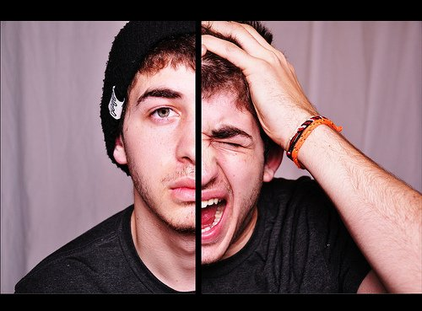
The answer is… (drumroll please)
COPING MECHANISMS
- How an individual is able to effectively handle and overcome stressful situations so as to avoid chronic stress or stress overload

Slide 8
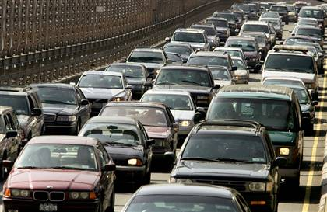
Chronic Stress
or Stress Overload
What is it?
Experiencing sustained stressful situations that wear you down day after day and year after year, with no visible escape.
Consider it also to be the point at which an individual loses the ability to cope with their stressors over time.

Slide 9
Effects of Chronic Stress
Research suggests that 60-90% of most reported illnesses are stress-related.
Physical wear & tear:
Damage to cardiovascular system (heartburn, high blood pressure, heart disease)
Immune system suppression
Inability to fight disease and infection
Irregular/interrupted digestion (ulcers, IBS)
Infertility

Slide 10
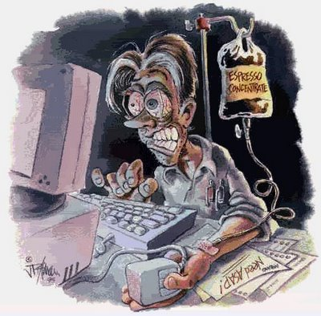
Effects of Chronic Stress
In addition to physical effects, chronic stress also grinds away at your mental health.
Long-term stress can rewire the brain and leave you more vulnerable to health problems such as:
Anxiety
Depression
Eating Disorders
Substance Abuse

Slide 11
Warning Signs and Symptoms of Chronic Stress
Cognitive Emotional
- Memory problems - Moodiness
Indecisiveness - Restlessness
- Poor judgement - Inability to relax
Physical Behavioural
Headaches - Substance Abuse
Insomnia - Nervous habits
Weight gain/loss - Picking fights

Slide 12
Keeping Stress Under Control
The most helpful thing to learn in coping with your stressors is to gain an understanding of how to manage the stress that comes along with any new challenge, good or bad.
These stress management skills work best when used regularly, and not just when the pressure’s on!

Slide 13
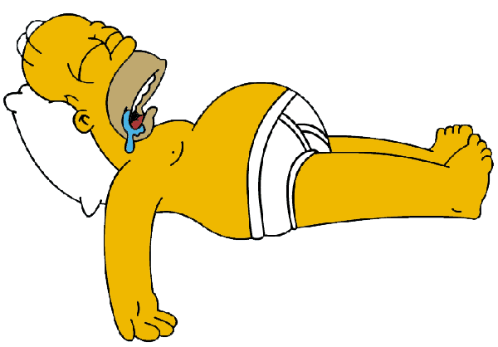
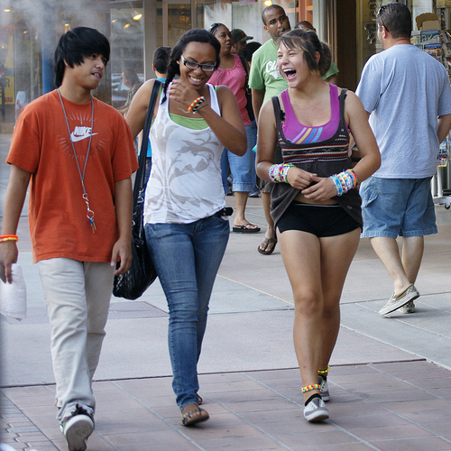
Coping Mechanisms
Take a stand against over-scheduling
Be realistic and recognize your limits
Get a good night’s sleep
Learn to relax
Treat your body well: health & wellness
Don’t sweat the small stuff, talk it out
Make time for friends, fun and laughter
Prioritize tasks and your time

